Slide 1
Lines of latitude to know*:
Equator (O°) starting point to number parallels
Tropic of Cancer (23.5° N)
Tropic of Capricorn (23.5° S)
Arctic Circle (66.5° N)
Antarctic Circle (66.5° S)
45° N (our latitude)
*we will explain their significance later

Slide 3
Geographic Information Systems (GIS)
GIS is defined as any system which facilitates the analysis of multiple layers of spatial data (maps of specific themes)

Slide 4
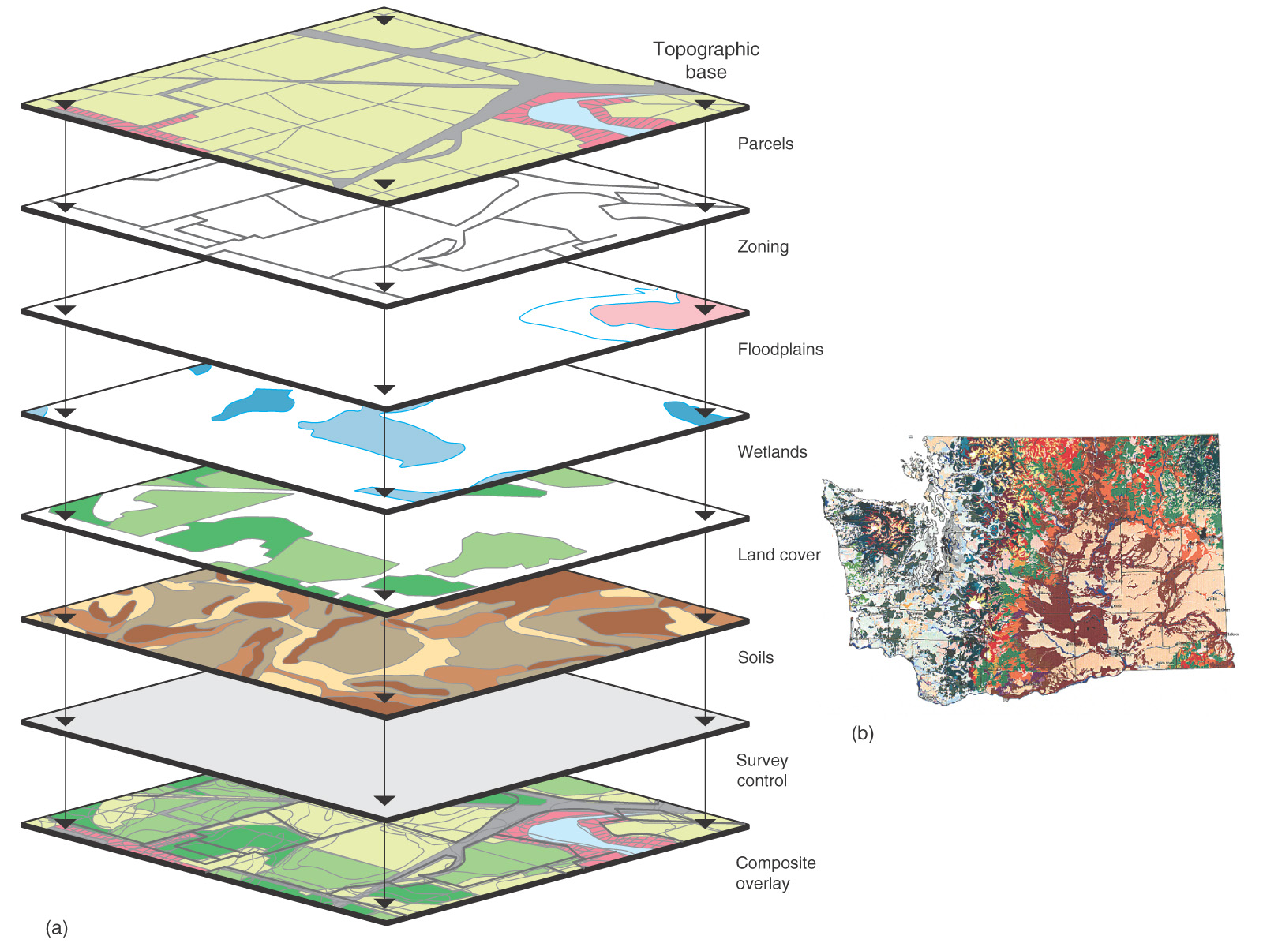

GIS System
Figure 1.23

Slide 5
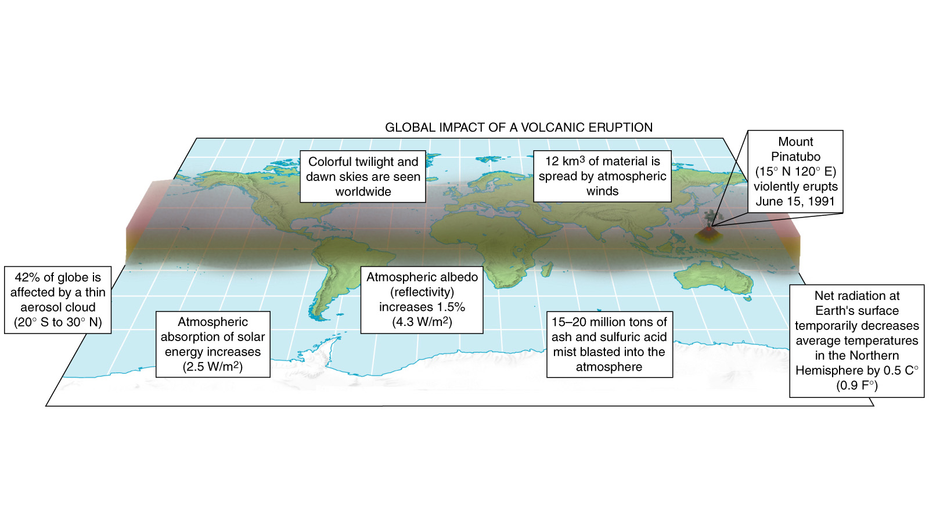
Global Effects of
Mount Pinatubo
Figure 1.5

Slide 6
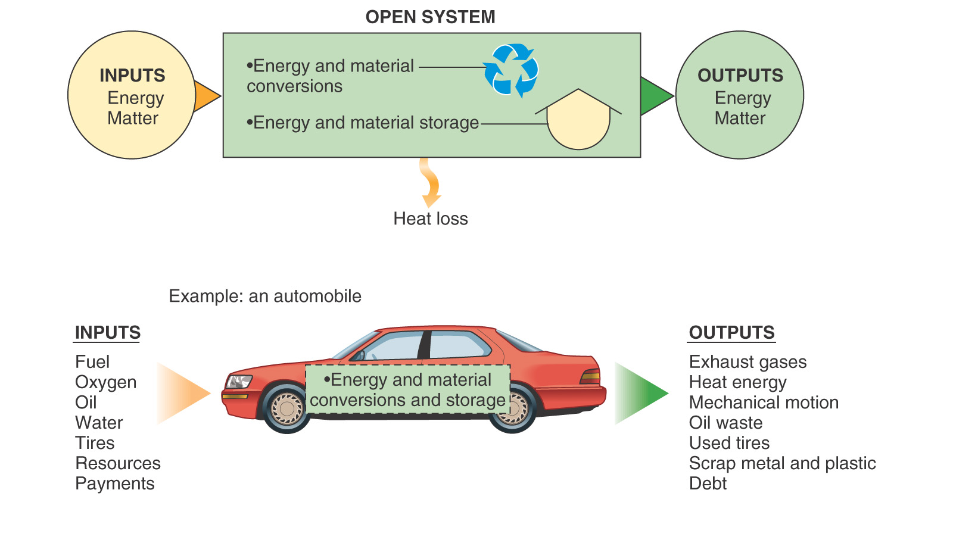
Figure 1.3

